Slide 1
Small Animal Breeds
Vet Science CDE

Slide 2
Cat Breeds

Slide 3
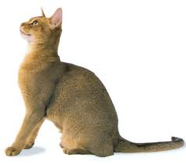
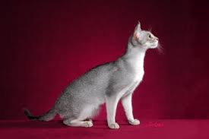
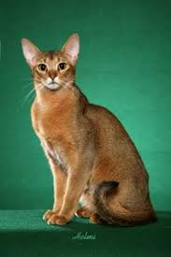
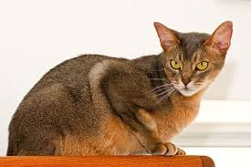
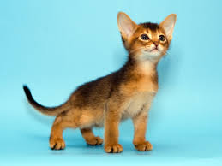
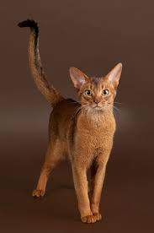
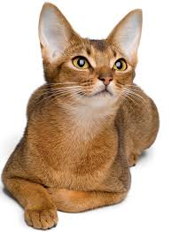
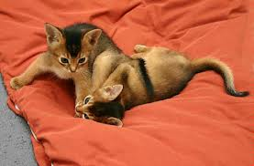
Abyssinian

Slide 4
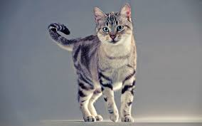
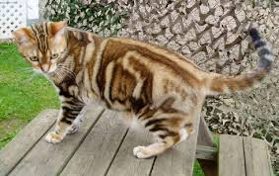
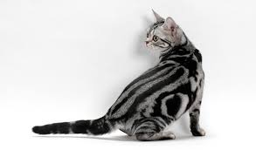
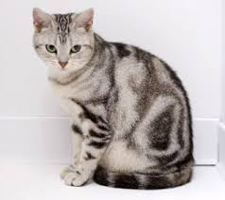
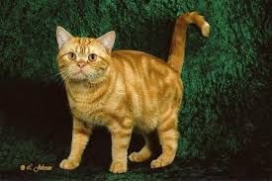
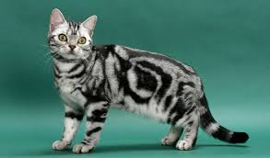
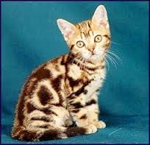
American Shorthair

Slide 5
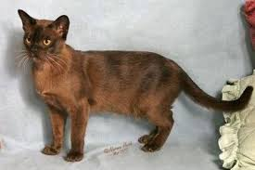
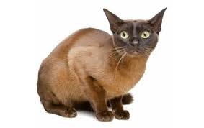
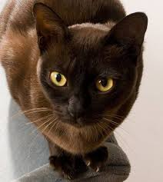
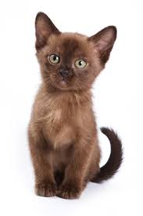
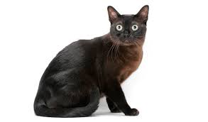
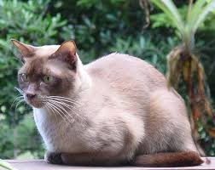
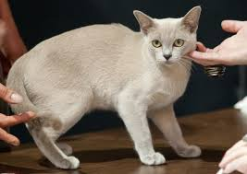
Burmese

Slide 6
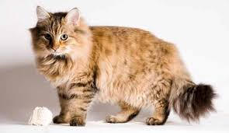
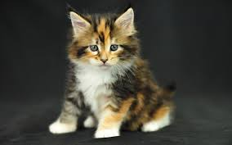
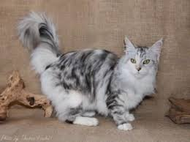
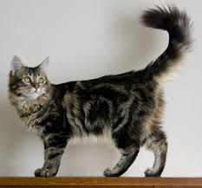
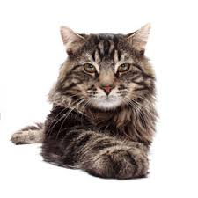
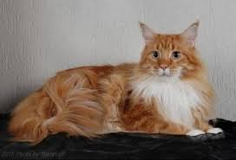
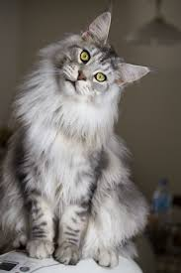
Maine Coon

Slide 7
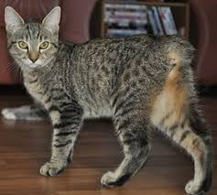
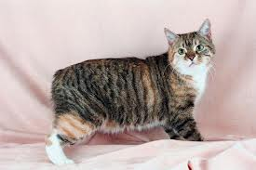
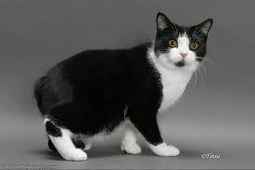
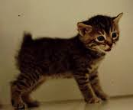
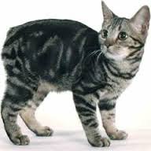
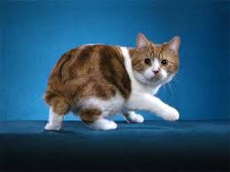
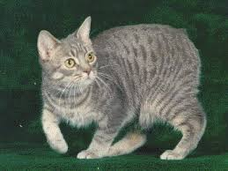
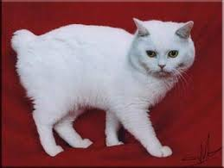
Manx

Slide 8
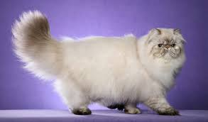
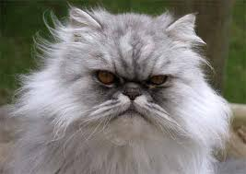
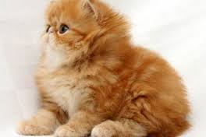
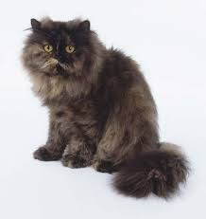
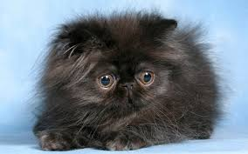
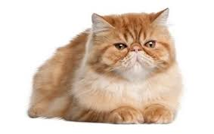
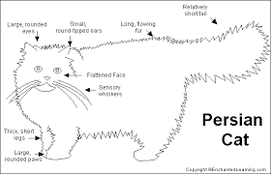

Persian

Slide 9
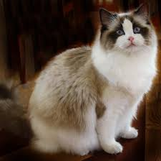
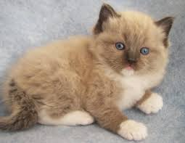
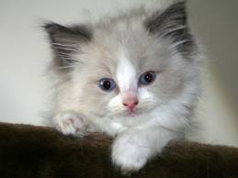
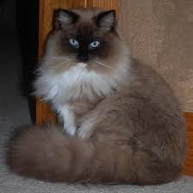
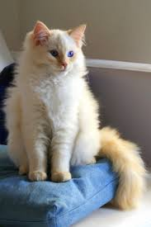
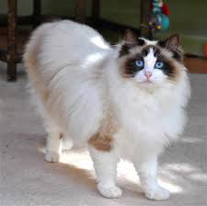


Ragdoll

Slide 10







Russian Blue

Slide 11







Siamese

Slide 12







Sphynx

Slide 13
Rabbit Breeds

Slide 14




Angora
Breed Description
Weight: 5-10 pounds
Color: variety of colors
Body: long silky hair

Slide 15

Californian
Breed Description
Weight: 8-12 pounds
Color: white, with black nose, ears, feet and tail
Body: rounded body, medium build, and short smooth coat

Slide 16

Dutch
Breed Description
Weight: 3.5-5.5 pounds
Color: white with back, blue or brown, chocolate, steel or tortoise
Body: The front of the face, body and the back feet are white, the rest is colored

Slide 17

English Spot
Breed Description
Weight: 5-8 pounds
Color: white with black, blue, chocolate, gold, grey, lilac or tortoise. Markings include butterfly mark on nose, colored ears, eye rings, spine marking (which is herringboned) and a spot on the cheek and a chain of spots along the body
Body: Long arched body (like a hare)

Slide 18

Netherland Dwarf
Breed Description
Weight: Under 2.5 pounds
Color:self group, shaded group, agouti group, tan pattern group, fawn, himilayan, orange, steel, tortoiseshell
Body: Ears seem too short for head

Slide 19

Mini-Rex
Breed Description
Weight: 3-4.5 pounds
Color: black, blue, broken group, castor, chinchilla, chocolate, Himalayan, lilac, lynx, opal, red, seal tortoise. white

Slide 20
Birds

Slide 21









Cockatiel

Slide 22








Cockatoo

Slide 23






Love Birds

Slide 24






Parakeet

Slide 25






African Grey Parrot

Slide 26







Canary

Slide 27








Macaw

Slide 28








Sun Conure

Slide 29







Zebra Finch

Slide 30
Small Mammals

Slide 31







Chinchilla

Slide 32







Ferret

Slide 33







Gerbil

Slide 34






Guinea Pig (Cavy)

Slide 35








Hamster

Slide 36







Hedgehog

Slide 37







Sugar Glider

Slide 38
Reptiles

Slide 39

Chameleon

Slide 40

Gecko

Slide 41

Iguana

Slide 42

Lizard

Slide 43

Bearded Dragon

Slide 44
Poultry
Veterinary Science

Slide 45







Chicken- Cornish

Slide 46








Chicken- Leghorns

Slide 47








Chicken- Plymouth Rock

Slide 48








Chicken- Rhode Island Red

Slide 49








Duck

Slide 50







Goose

Slide 51








Quail

Slide 52







Turkey

