Slide 1
Identification of Insects
By: Daniela Rodriguez

Slide 2
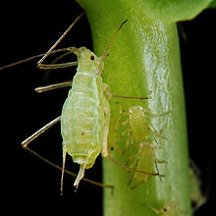
DESCRIPTION:
are small sap sucking insects, among the most destructive insect pests on cultivated plants in temperate regions.[

Slide 3
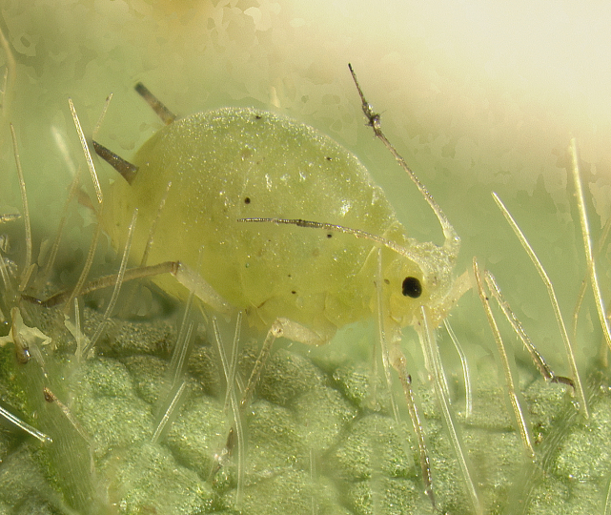
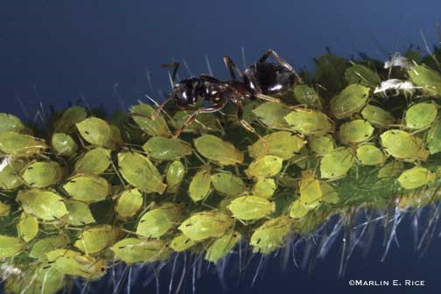
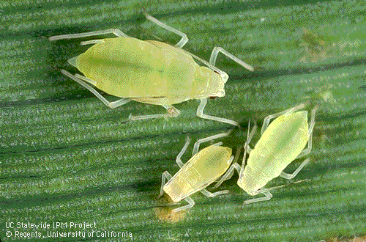
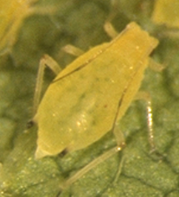
APHIDS

Slide 4
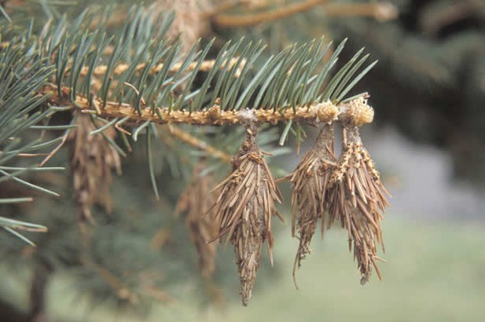
DESCRIPTION:
is the larval stage of a moth native to Pennsylvania that is reported to feed on over 100 different plants, common in the southern part of the state

Slide 5
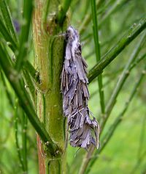
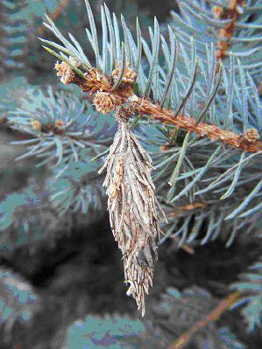
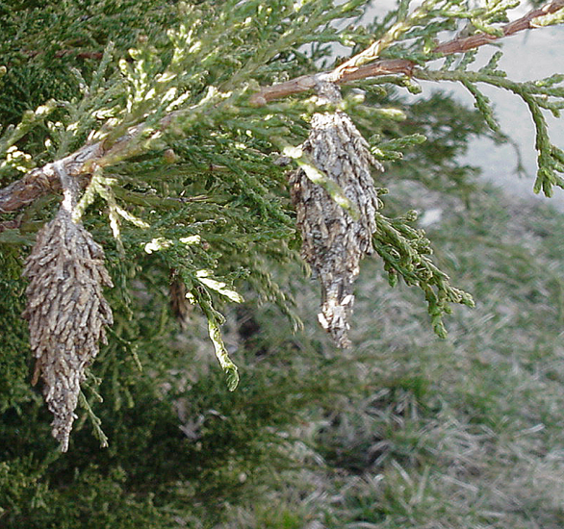
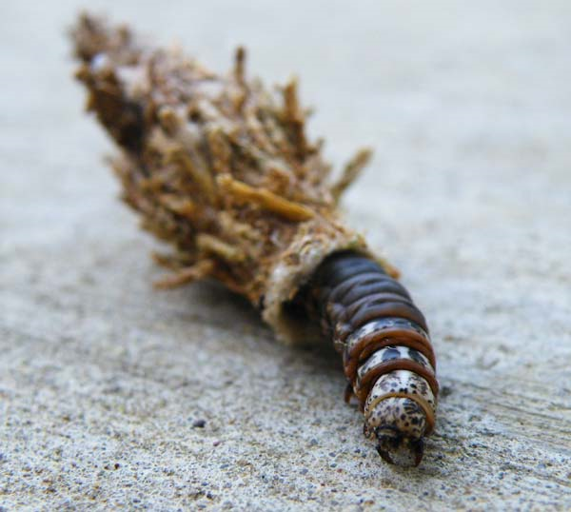
BAGWORM

Slide 6
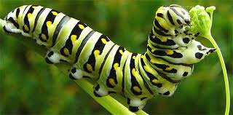
DESCRIPTION:
the larval form of members of the order Lepidoptera (the insect order comprising butterflies and moths), voracious feeders and many of them are considered to be pests in agriculture

Slide 7
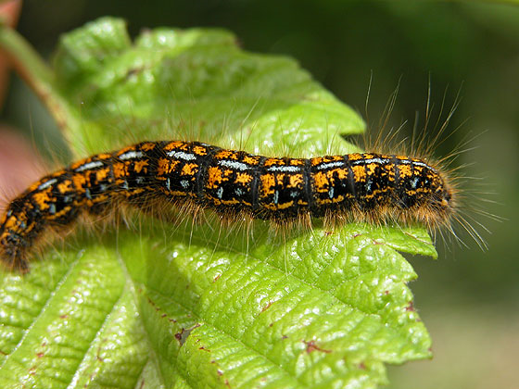
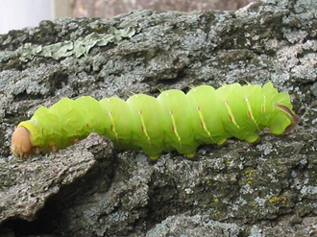
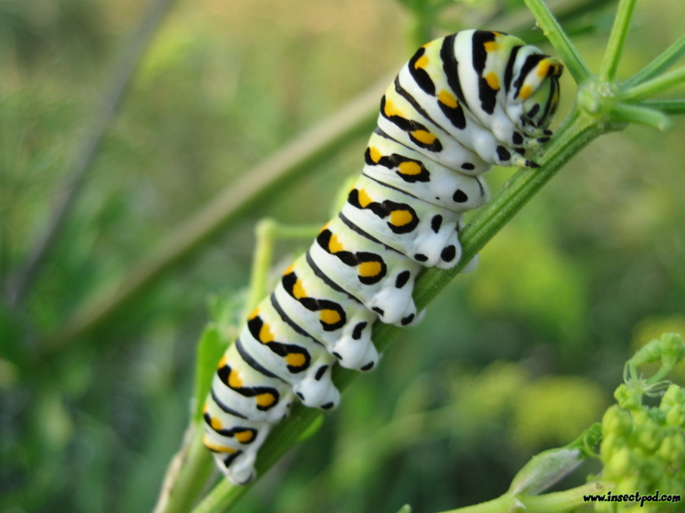
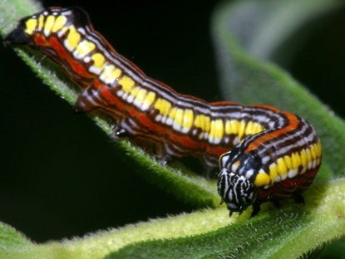
CATERPILLAR

Slide 8
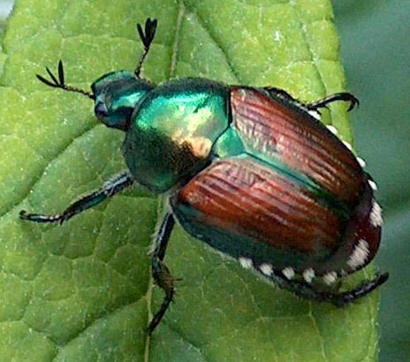
DESCRIPTION:
iridescent copper-colored elytra and green thorax and head, It is a clumsy flier, dropping several centimeters when it hits a wall

Slide 9
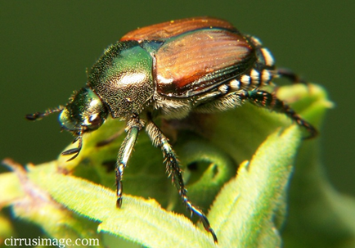
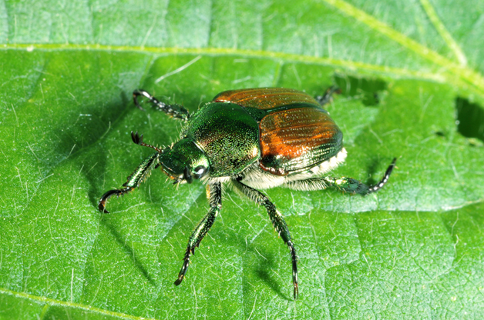
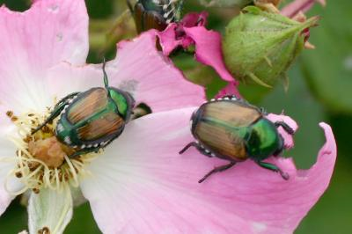
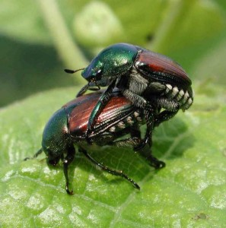
JAPANESE BEETLE

Slide 10
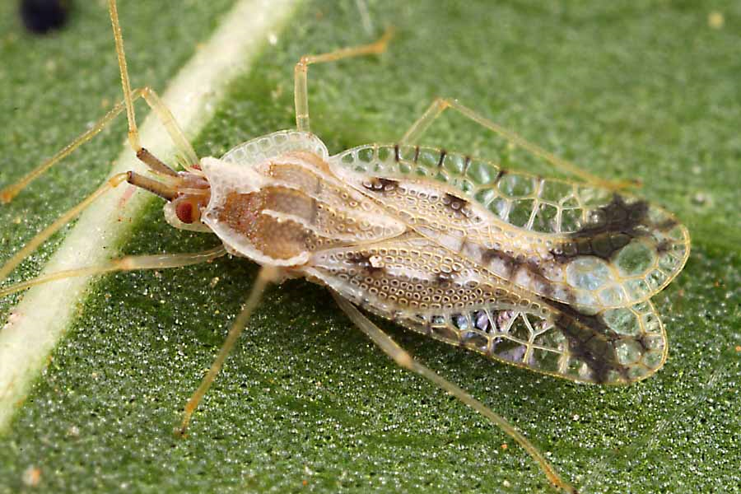
DESCRIPTION:
netlike pattern on the wings, which are dotted with brown and black. The eggs, although small, are easily distinguished by their elongate and cylindrical shape.

Slide 11
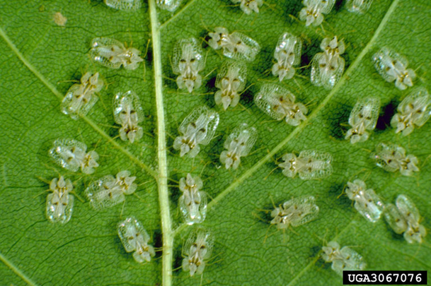
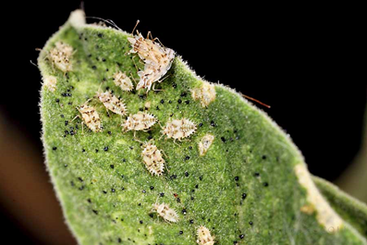
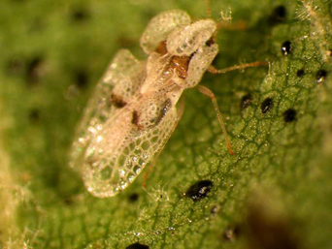
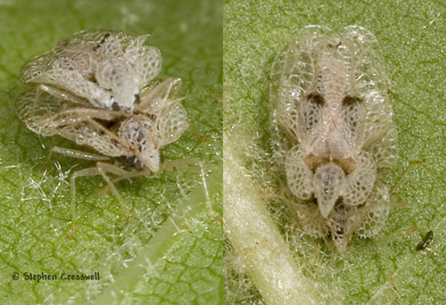
LACEBUG

Slide 12
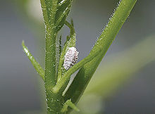
DESCRIPTION: unarmored scale insects found in moist, warm climates. They are considered pests as they feed on plant juices of greenhouse plants, house plants and subtropical trees.

Slide 13
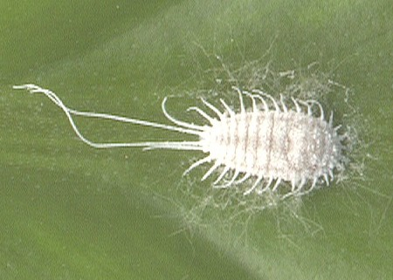
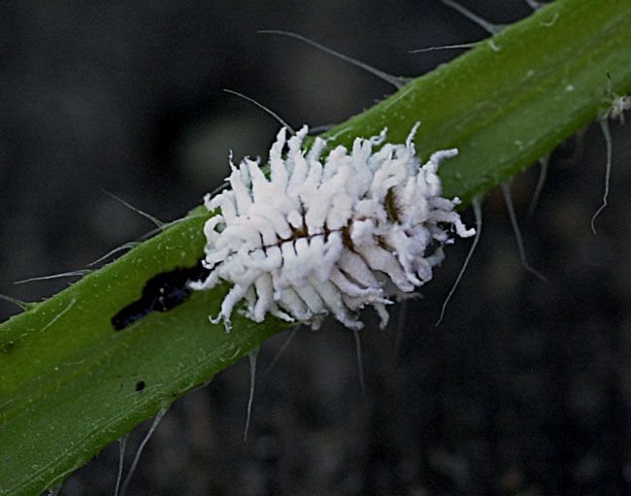
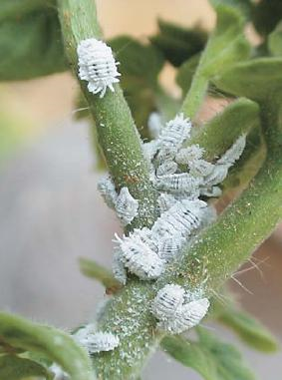
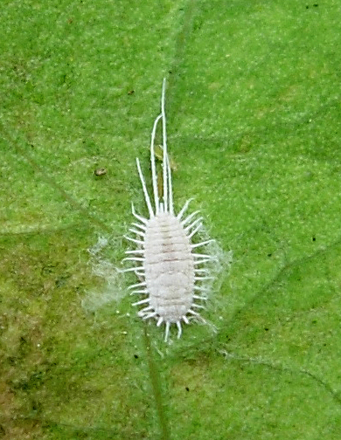
MEALYBUG

Slide 14
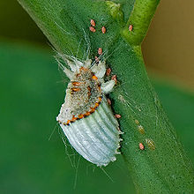
DESCRIPTION:
Small insects of the order Hemiptera, generally classified as the superfamily Coccoidea. There are about 8,000 species of scale insects. Adult males can have wings but never feed and die within a day or two

Slide 15
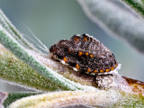
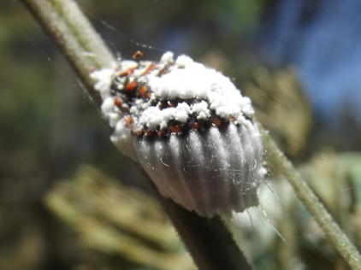
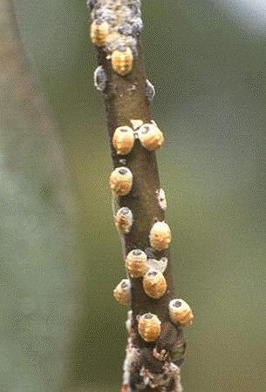
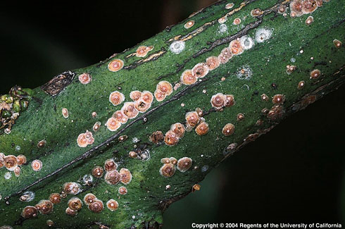
SCALE

Slide 16
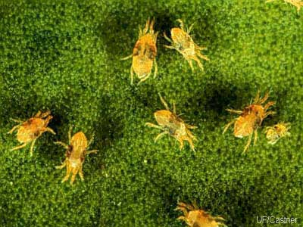
DESCRIPTION:
They generally live on the under sides of leaves of plants, where they may spin protective silk webs, and they can cause damage by puncturing the plant cells to feed.[2] Spider mites are known to feed on several hundred species of plant.

Slide 17
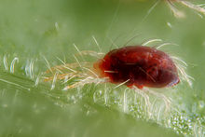
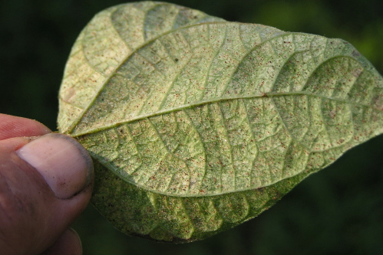
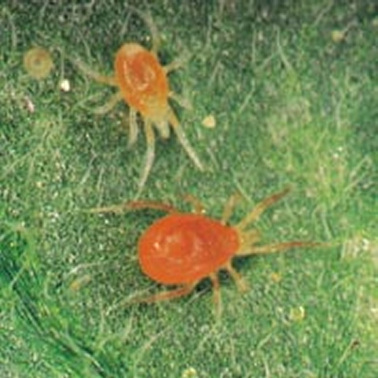
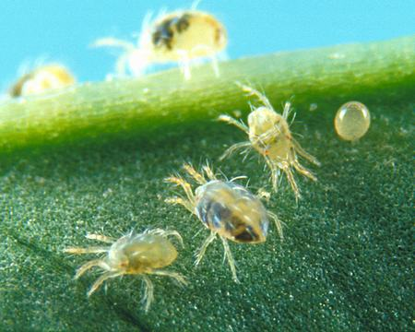
SPIDER MITES

Slide 18
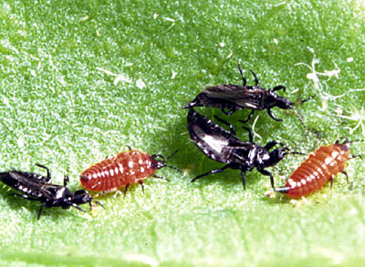
DESCRIPTION: species feed on a large variety of sources, both plant and animal, by puncturing them and sucking up the contents. A large number of thrips species are considered pests, because they feed on plants with commercial value.

Slide 19
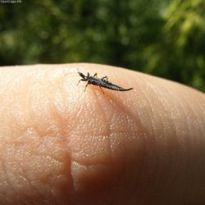
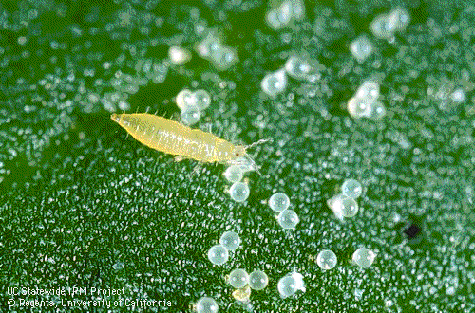
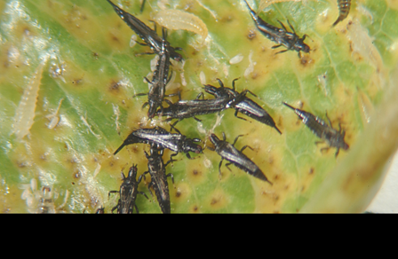
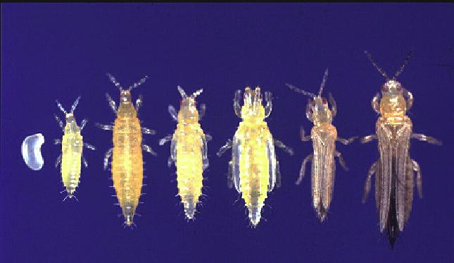
THRIPS

Slide 20
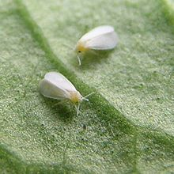
DESCRIPTION:
Whiteflies typically feed on the underside of plant leaves. Introducing toxic saliva and decreasing the plants' overall turgor pressure

Slide 21
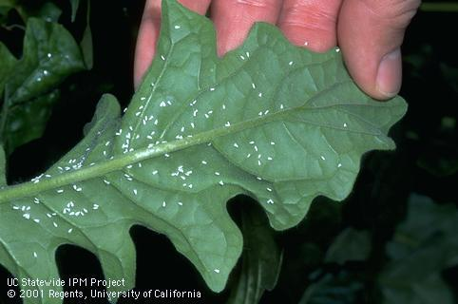
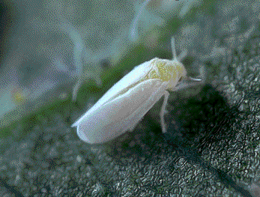
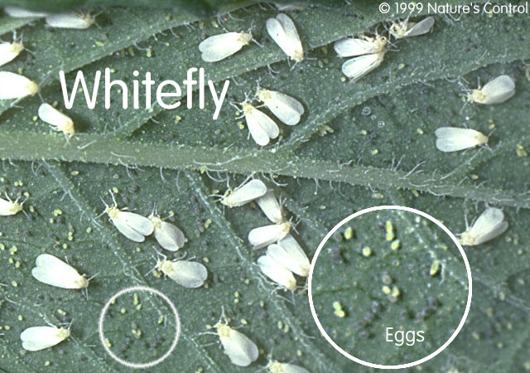
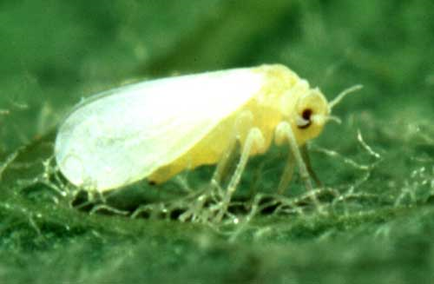
WHITE FLIES

