Slide 1
Vet Science Equipment
2016

Slide 2
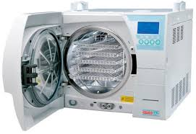
Autoclave

Slide 3
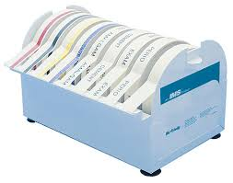
Autoclave Tape Indicator

Slide 4
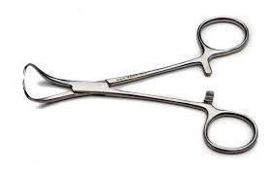
Backhaus Towel Clamps

Slide 5
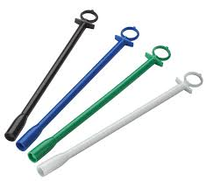
Balling Gun

Slide 6
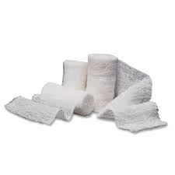
Bandaging Material – Roll Gauze

Slide 7
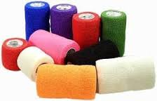
Bandaging Material – Vet Wrap

Slide 8
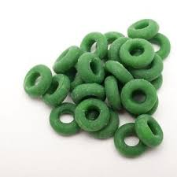
Bands (Castration or Docking)

Slide 9

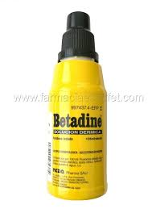
Betadine

Slide 10
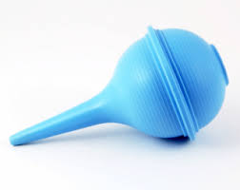
Bulb Syringe

Slide 11
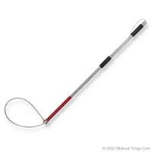
Catch Pole (Dog Snare)

Slide 12
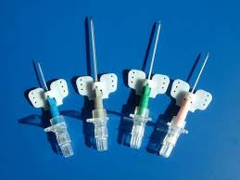
Catheter - Butterfly

Slide 13
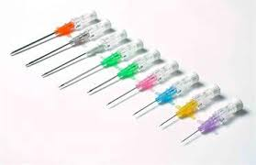
Catheter - IV

Slide 14
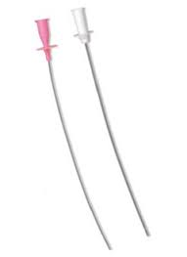
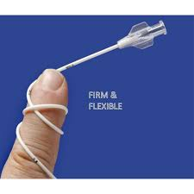
Catheter – Tomcat Urinary

Slide 15
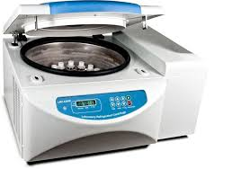
Centrifuge

Slide 16
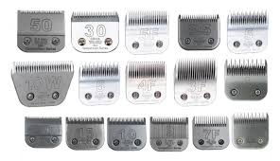
Clipper Blades

Slide 17
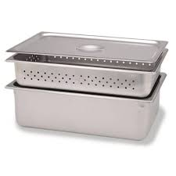
Cold Sterile Tray

Slide 18
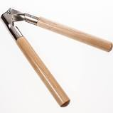
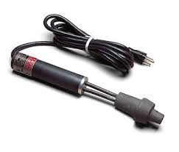
Dehorner

Slide 19
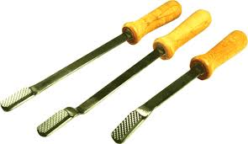
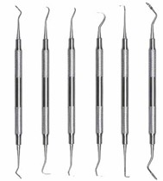
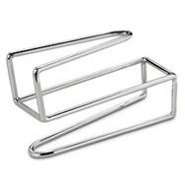
Dental Equipment (Float, Retractor or Scaler)

Slide 20
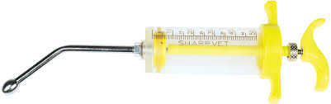
Drench Gun (Small Ruminant)

Slide 21
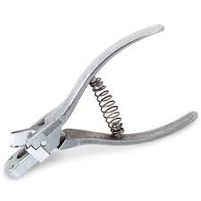
Ear Notcher

Slide 22
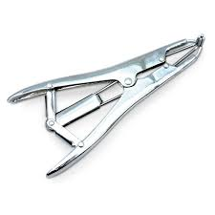
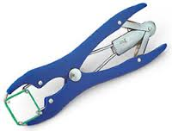
Elastrator

Slide 23
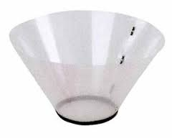
Elizabethian Collar

Slide 24
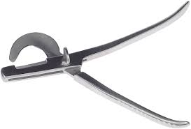
Emasculators

Slide 25
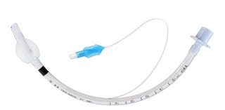
Endotracheal Tubes

Slide 26
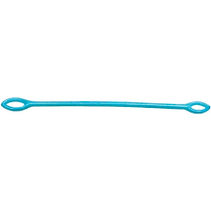
Fecal Loop

Slide 27
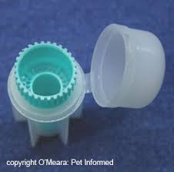
Fecalyzers

Slide 28
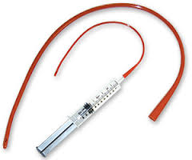
Feeding Tube for Small Animals

Slide 29
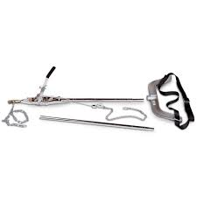
Fetal Extractor - Calf

Slide 30
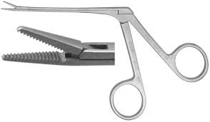
Forceps – Alligator

Slide 31
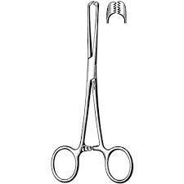
Forceps – Allis Tissue

Slide 32
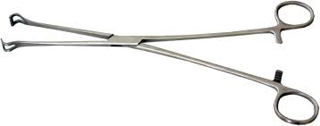
Forceps – Babcock Tissue

Slide 33
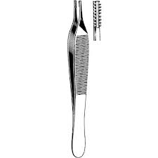
Forceps – Brown-Adson Thumb

Slide 34
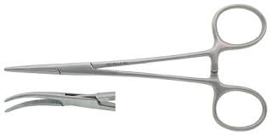
Forceps – Halstead Mosquito Hemostatic

Slide 35
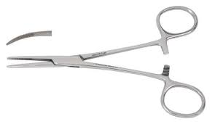
Forceps – Kelly

Slide 36
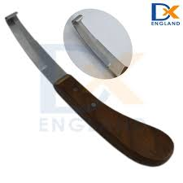
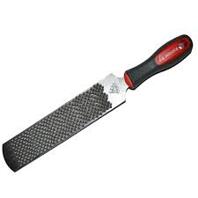
Hoof Equipment (Knife or Rasp)

Slide 37
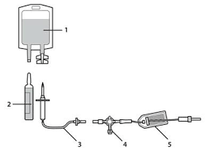
IV Administration Kit

Slide 38
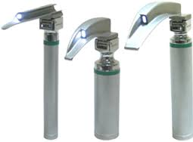
Laryngoscopes

Slide 39
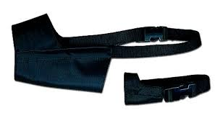
Muzzle – Nylon

Slide 40
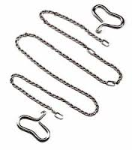
Obstetrical Chain and Handle

Slide 41
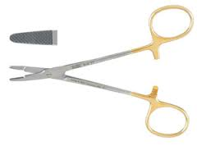
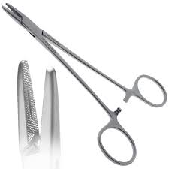
Needle Holder (Mayo-Hegar or Olsen Hegar)

Slide 42
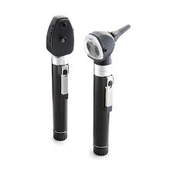
Ophthalmoscope

Slide 43
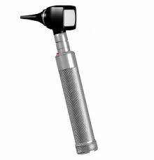
Otoscope

Slide 44
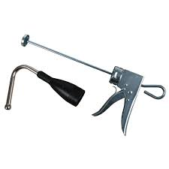
Paste Gun

Slide 45

Pig Tooth Nippers

Slide 46

Pill Counting Tray

Slide 47

Rumen Magnet

Slide 48

Scalpel Blade

Slide 49

Scalpel Handle

Slide 50





Scissors (Bandage, Lister Bandage, Littauer Suture Removal, Mayo Dissecting, Metzenbaum Dissecting)

Slide 51

Silver Nitrate Sticks

Slide 52

Small Animal Oxygen Cage

Slide 53

Snook Ovariohysterectomy Hook

Slide 54

Staple Remover

Slide 55

Stethoscope

Slide 56

Surgical Drapes

Slide 57

Syringe

Slide 58

Tattooing Instruments – Small & Large

Slide 59


Tourniquet

