Slide 1
Nursery/Landscape Plant Identification
A-E
101-132

Slide 2
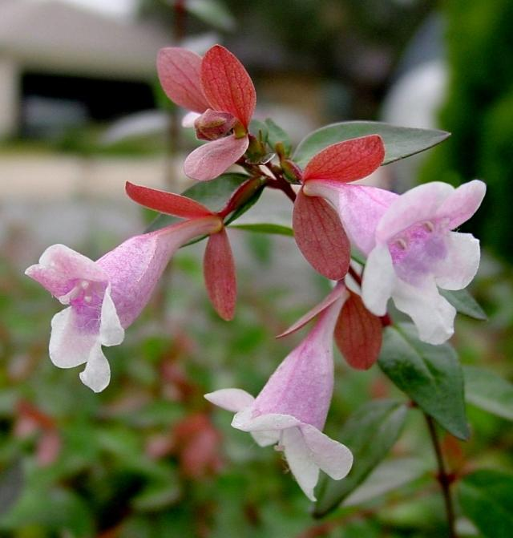
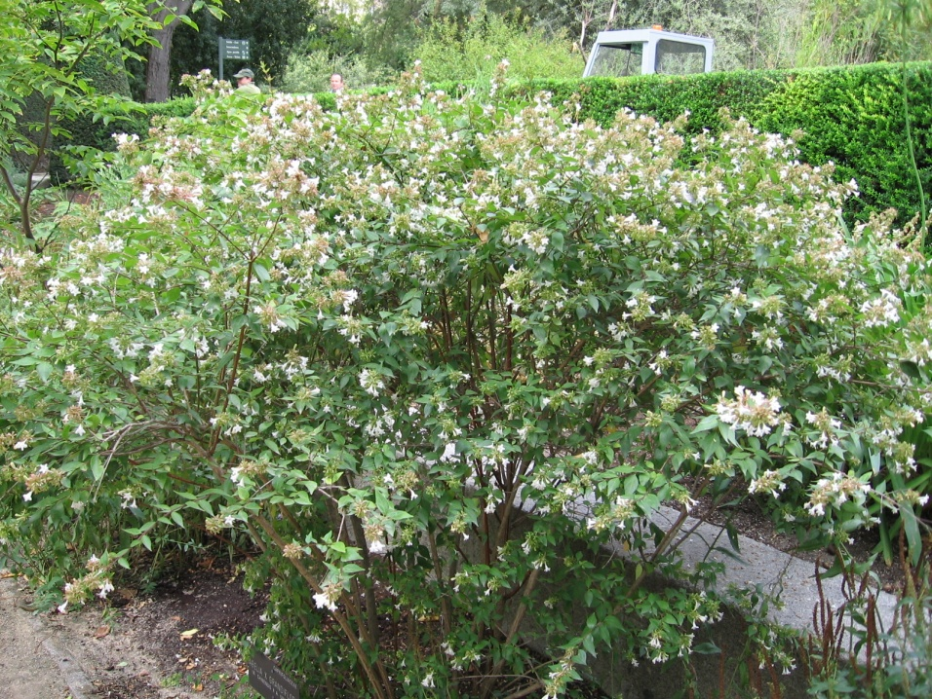
101
Abelia x grandiflora
Glossy Abelia
Davesgarden.com
wikimedia.org
Notes:
http://pics.davesgarden.com/pics/2003/12/15/htop/b7e65f.jpg
http://upload.wikimedia.org/wikipedia/commons/0/06/Abelia_x_grandiflora_03.jpg

Slide 3
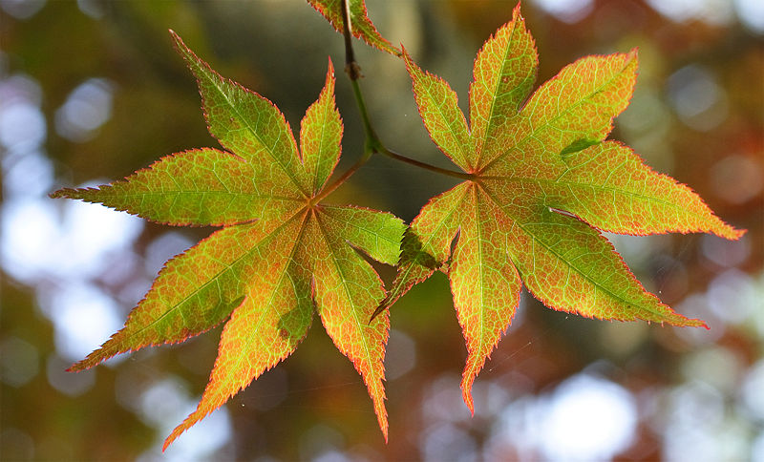
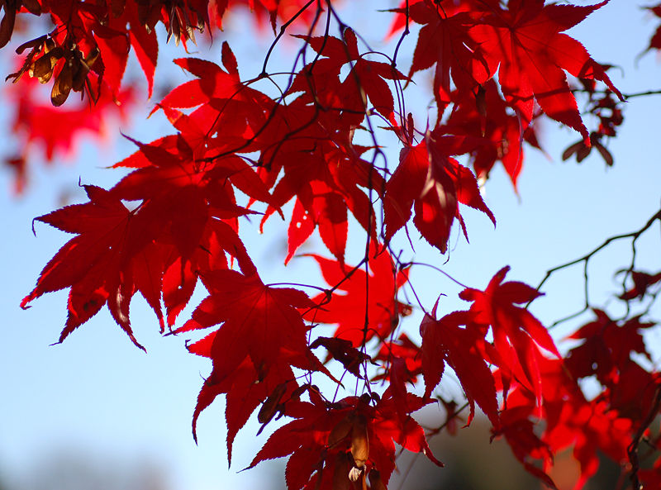

103
Acer palmatum cv.
Japanese Maple
Wikipedia.com
Notes:
Wikipedia.com

Slide 4
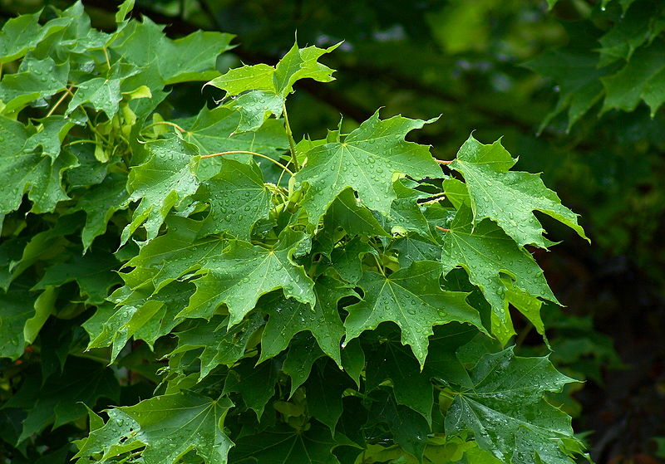
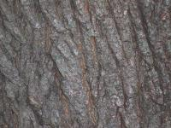
104
Acer platanoides cv.
Norway Maple
Wikipedia.com
Notes:
Wikipedia.com

Slide 5
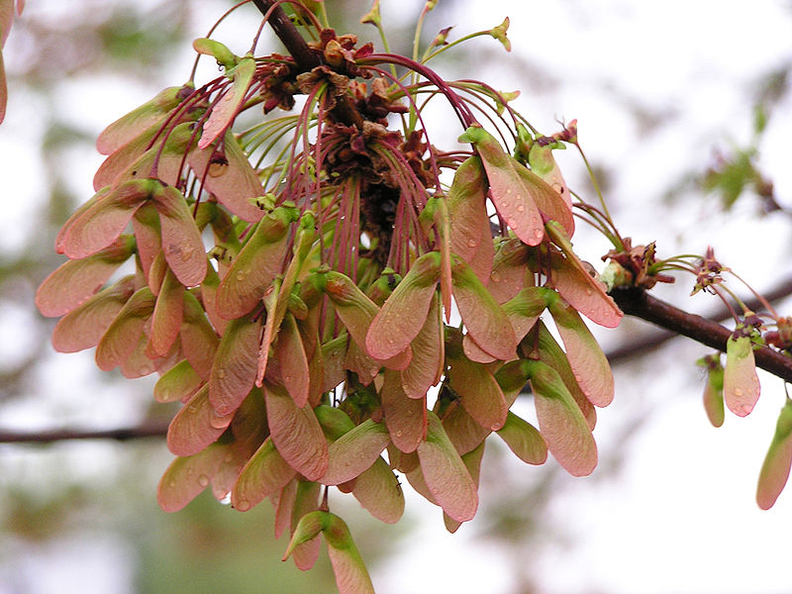
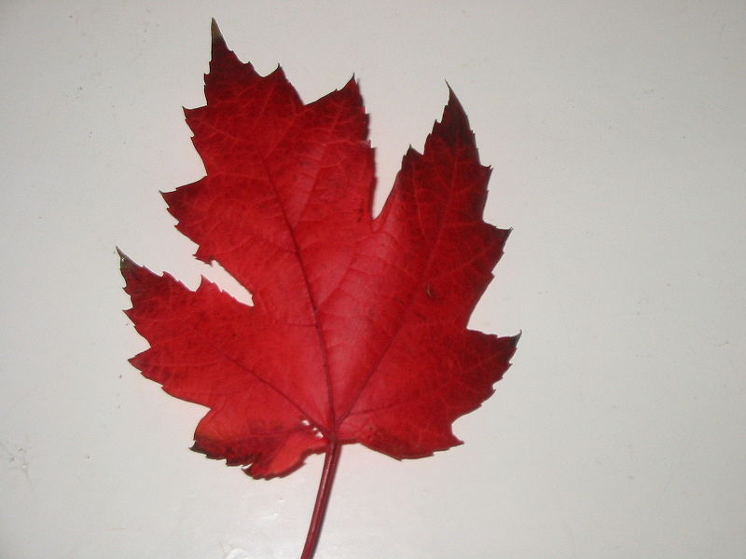
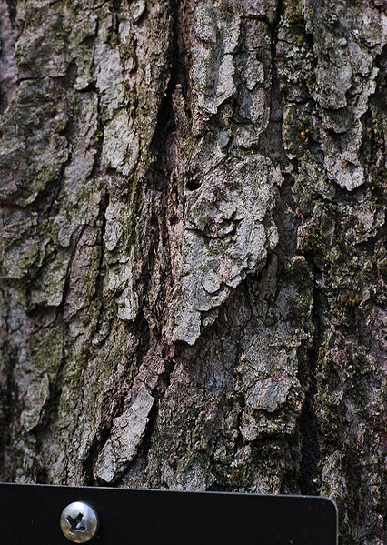
105
Acer rubrum cv.
Red Maple
Wikipedia.com
Notes:
Wikipedia.com

Slide 6
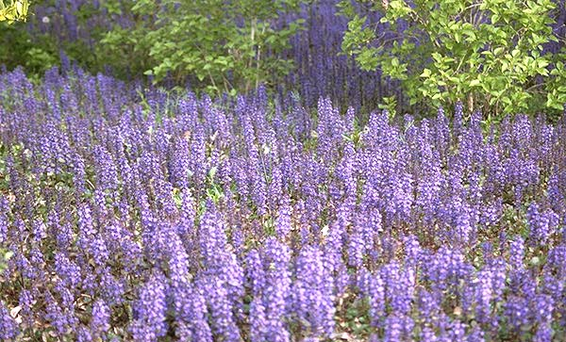
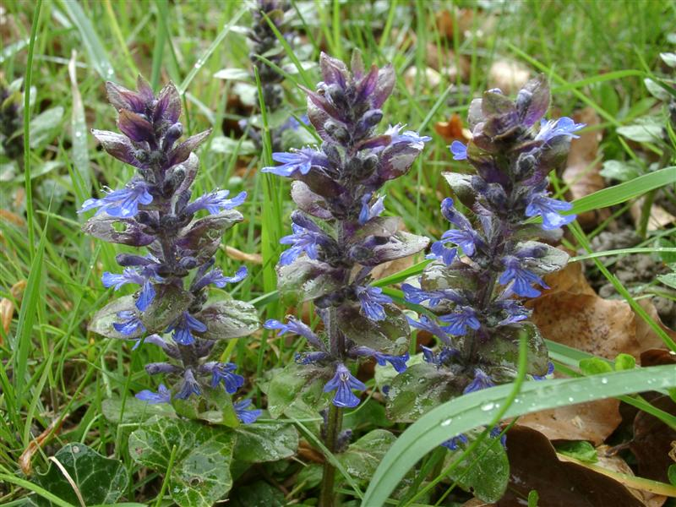
107
Ajuga reptans cv.
Carpet Bugle
ajuga.org/
floracyberia.net
Notes:
http://www.ajuga.org/images/Ajuga%20reptans%201.jpg
http://www.floracyberia.net/spermatophyta/angiospermae/dicotyledoneae/lamiaceae/ajuga_reptans.jpg

Slide 7
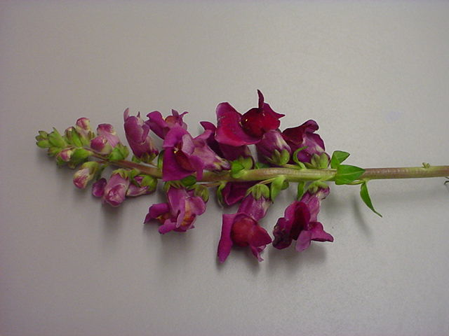
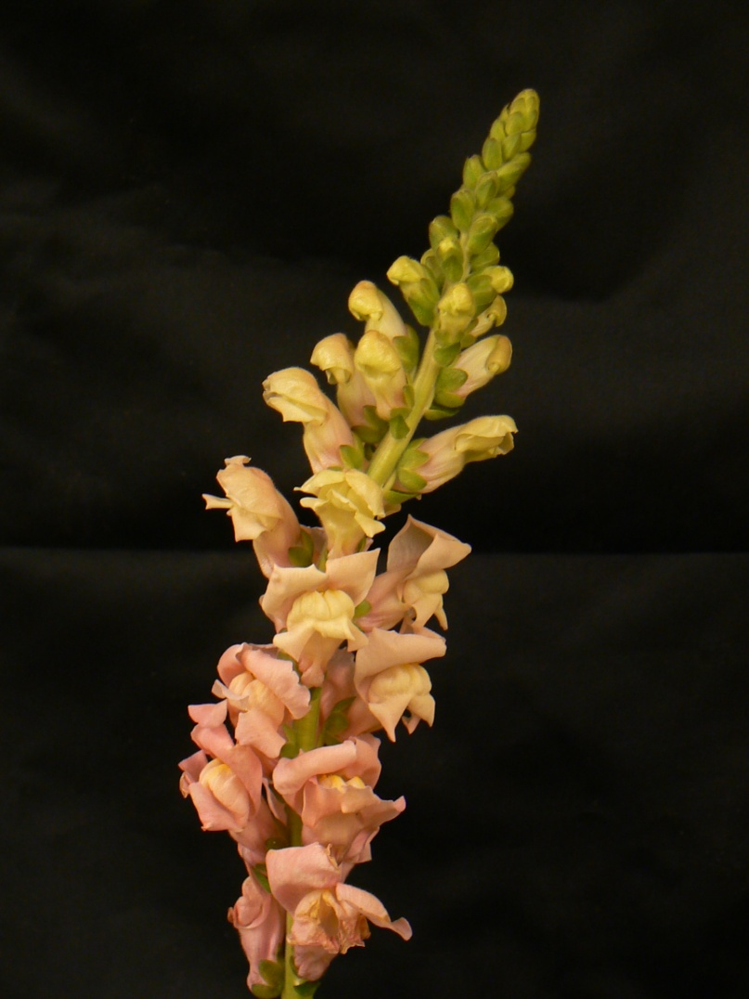
108
Antirrhinum majus cv.
Snapdragon

Slide 8
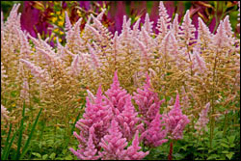
111
Astilbe hybrid cv.
Astilbe
Americanmeadows.com
Notes:
Americanmeadows.com

Slide 9
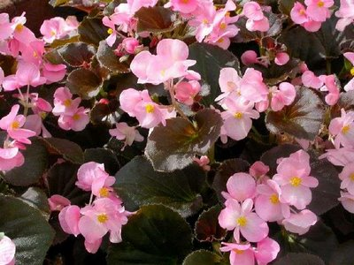
112
Begonia x semperflorens-cultorum
Wax Begonia
Bpl.blogger.com
Notes:
Bpl.blogger.com

Slide 10
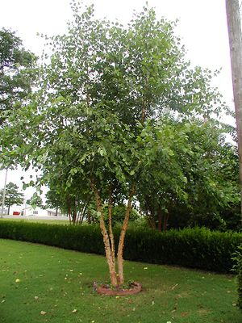
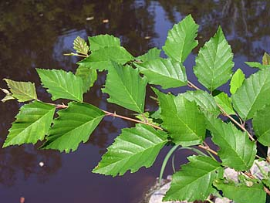
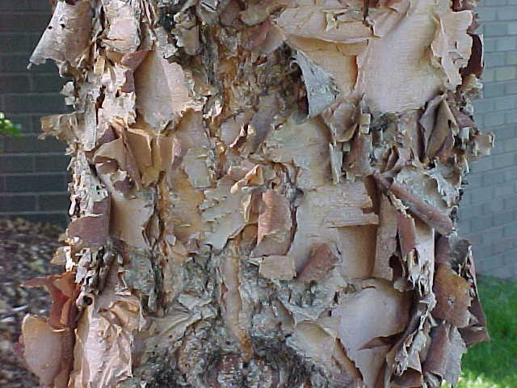
114
Betula nigra
River birch
talltreesgroup.com
duke.edu
soonerplantfarm.com
Notes:
http://www.talltreesgroup.com/Betula%20nigra.jpg
http://www.duke.edu/~cwcook/trees/beni3452.jpg
http://www.soonerplantfarm.com/_ccLib/image/plants/DETA-10.jpg

Slide 11
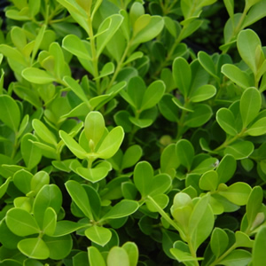
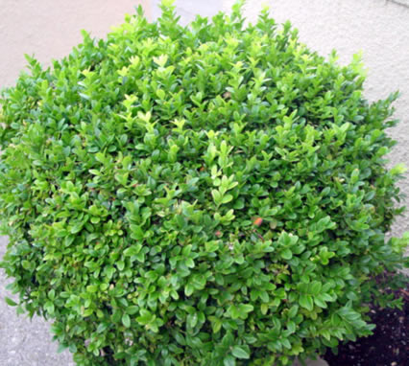
116
Buxus microphylla cv.
Littleleaf Boxwood
magnoliagardensnursery.com
hortiplex.gardenweb.com
Notes:
http://hortiplex.gardenweb.com/plants/jour/p/10/gw1006410/3356711002541905.jpeg
http://www.google.com/imgres?imgurl=http://www.magnoliagardensnursery.com/productdescrip/pictures300/Buxus_Jap300.jpg&imgrefurl=http://www.magnoliagardensnursery.com/productdescrip/Buxus_Japanese.html&usg=__xxid4svaagJuA_v6e0jBRs36e4k=&h=300&w=300&sz=53&hl=en&start=2&sig2=MdTIEuE_sDs4En9I_ZnBCg&itbs=1&tbnid=OB86S-jRD6jkLM:&tbnh=116&tbnw=116&prev=/images%3Fq%3DBuxus%2Bmicrophylla%26hl%3Den%26sa%3DG%26tbs%3Disch:1&ei=TAvOS6PGO6PutQO8kpyvDg

Slide 12
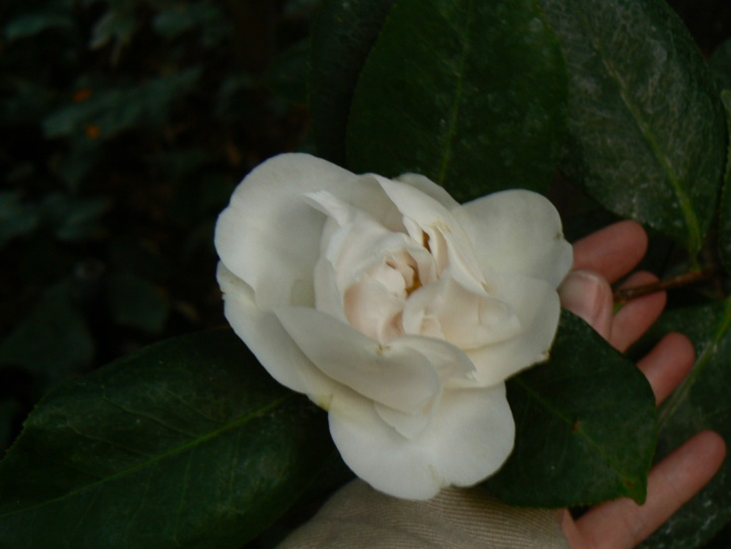
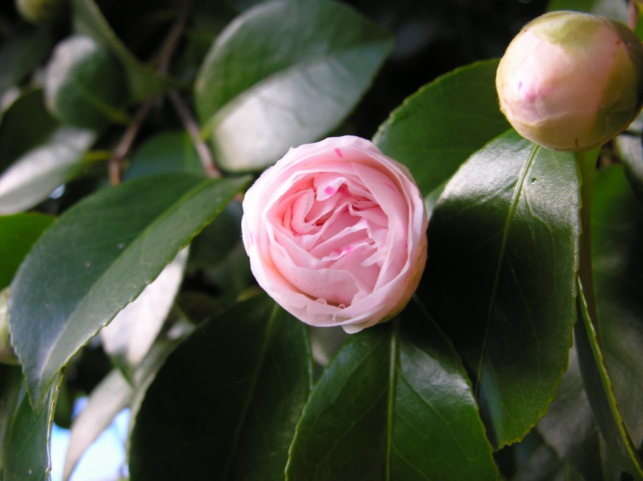
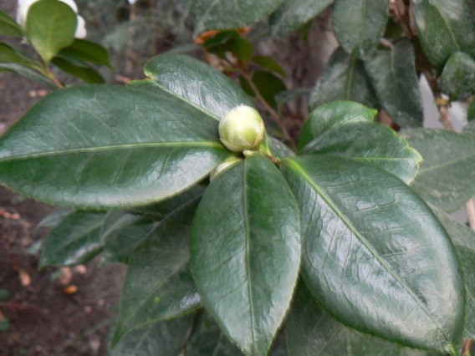
117
Camellia japonica cv.
Common Camellia
wikimedia.org
Notes:
Uploads.wikimedia.org

Slide 13
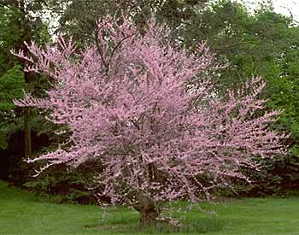
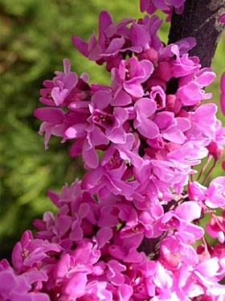
119
Cercis canadensis
Redbud
about-garden.com
greengrasslandscape.com
Notes:
http://www.greengrasslandscape.com/photogallery/Cercis%20canadensis.jpg
http://www.about-garden.com/images_data/3529-cercis-canadensis-forest-pansy-judas-tree.jpg

Slide 14
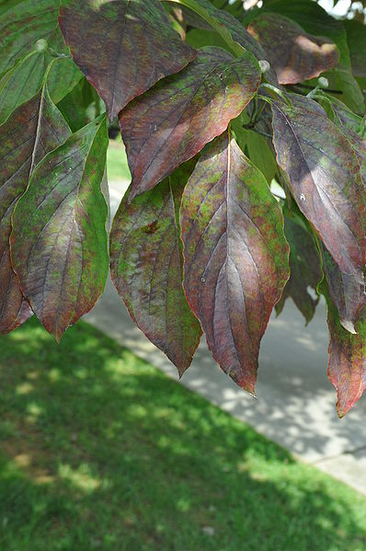
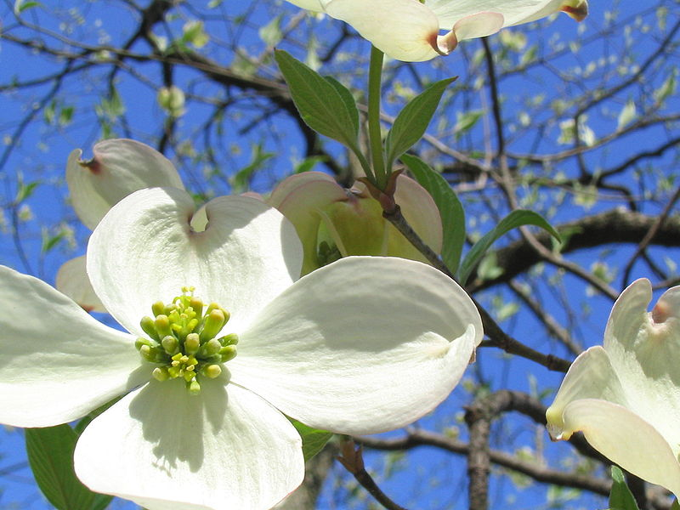
121
Cornus florida cv.
Flowering Dogwood
wikimedia.org
Notes:
(A flowering dogwood blooming in April in Missouri.)
({{Information |Description={{en|1=Leaves of the Cornus florida (flowering dogwood) in the fall.}} |Source=Own work by uploader |Author=EnLorax |Date=2008-09-28 |Permission= |other_versions= }} <!--{{ImageUpload|full}}--> [[Category:Cornu)

Slide 15
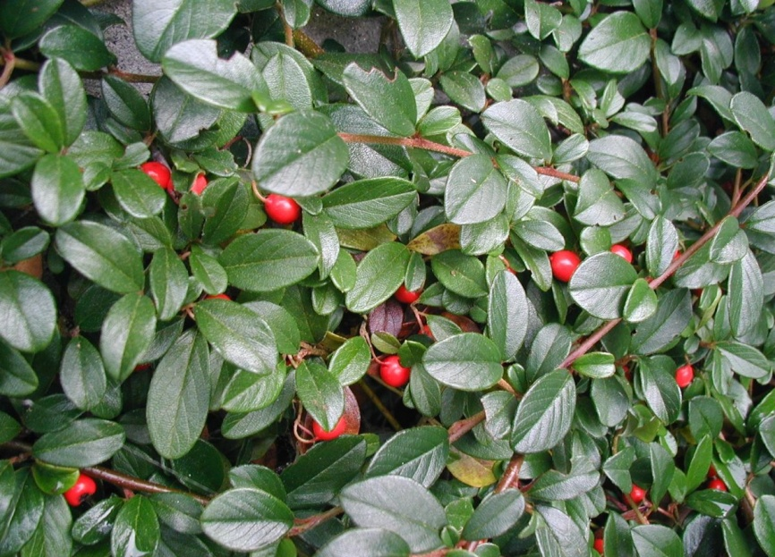
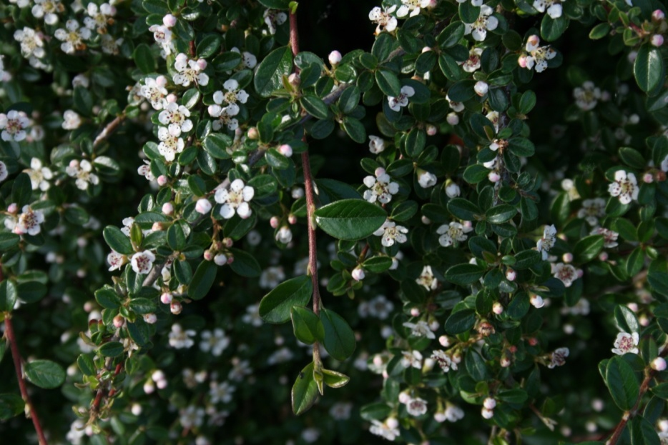
122
Cotoneaster dammeri
Bearberry Cotoneaster
wikimedia.org
Notes:
http://upload.wikimedia.org/wikipedia/commons/0/0d/Cotoneaster-dammeri-berries.JPG
http://upload.wikimedia.org/wikipedia/commons/7/75/Cotoneaster-dammeri-flowering.JPG

Slide 16
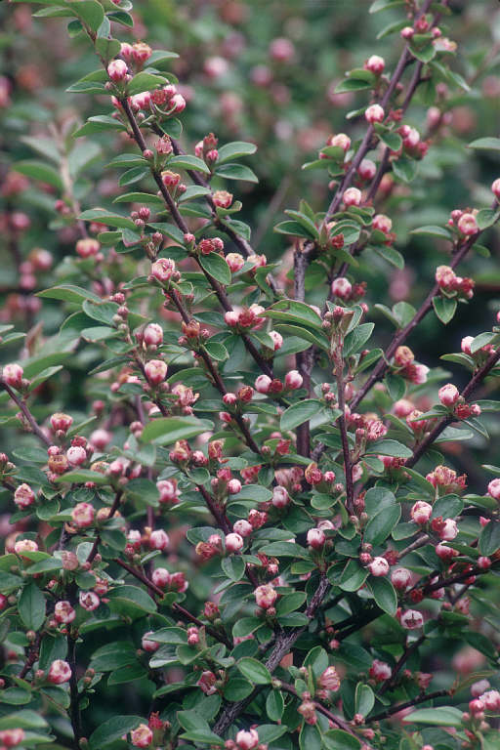
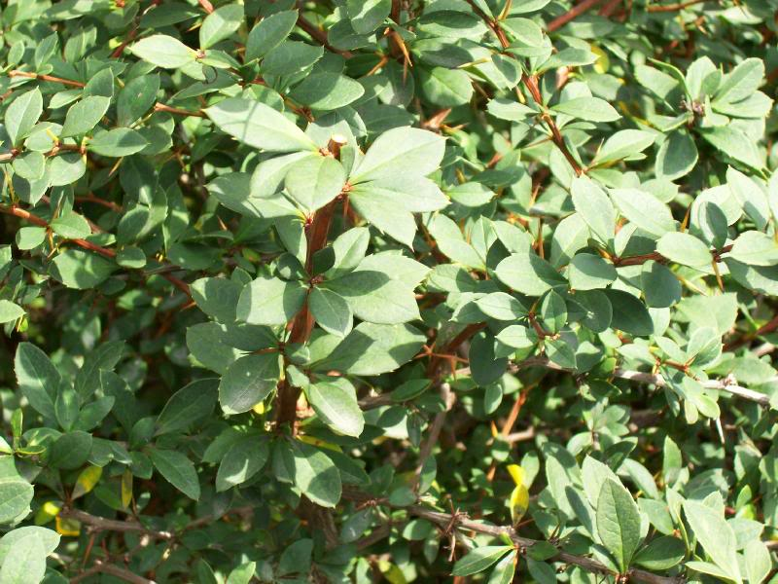
123
Cotoneaster divaricatus
Spreading Cotoneaster
image51.webshots.com
dkimages.com
Notes:
http://image51.webshots.com/51/6/70/45/456567045BGgcDM_ph.jpg
http://www.dkimages.com/discover/previews/925/715058.JPG

Slide 17
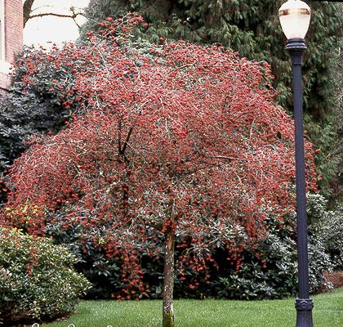
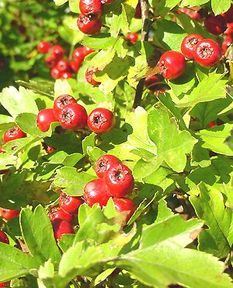
124
Crataegus phaenopyrum
Washington Hawthorn
soonerplantfarm.com
oregonstate.edu
Notes:
http://oregonstate.edu/dept/ldplants/images/crph12.jpg
http://www.soonerplantfarm.com/_ccLib/image/plants/DETA-44.jpg

Slide 18
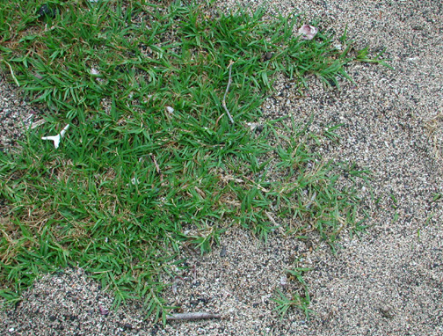
125
Cynodon dactylon cv.
Bermudagrass
US NPS photo
Notes:
Cynodon dactylon - US NPS photo )

Slide 19
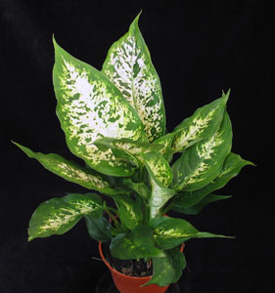
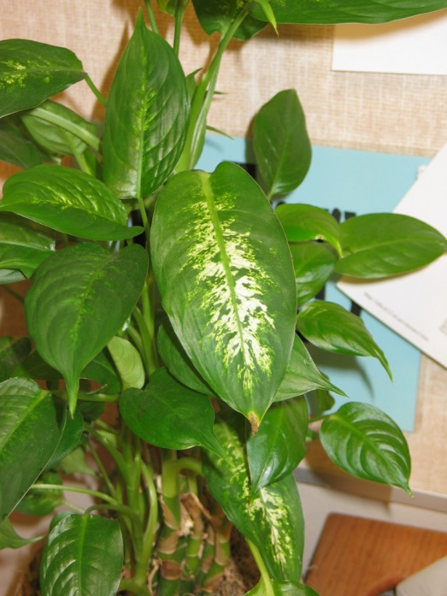
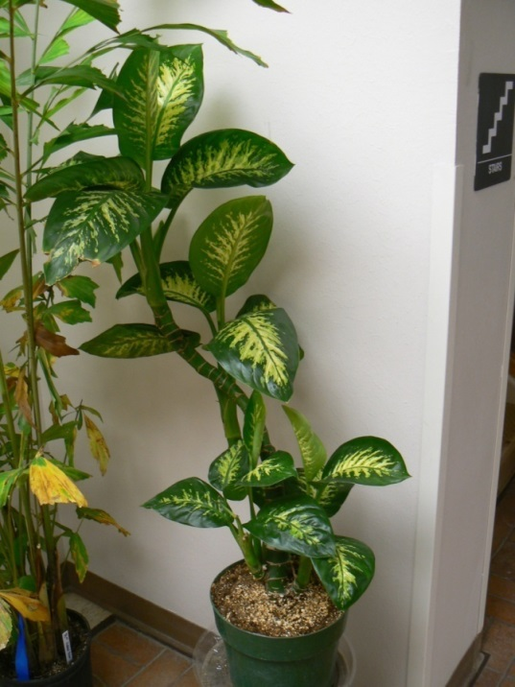
126
Dieffenbachia maculata cv.
Spotted Dumbcane
Flowerservant.com
Notes:
Flowerservant.com

Slide 20
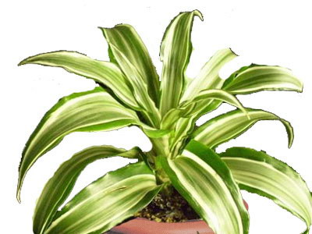
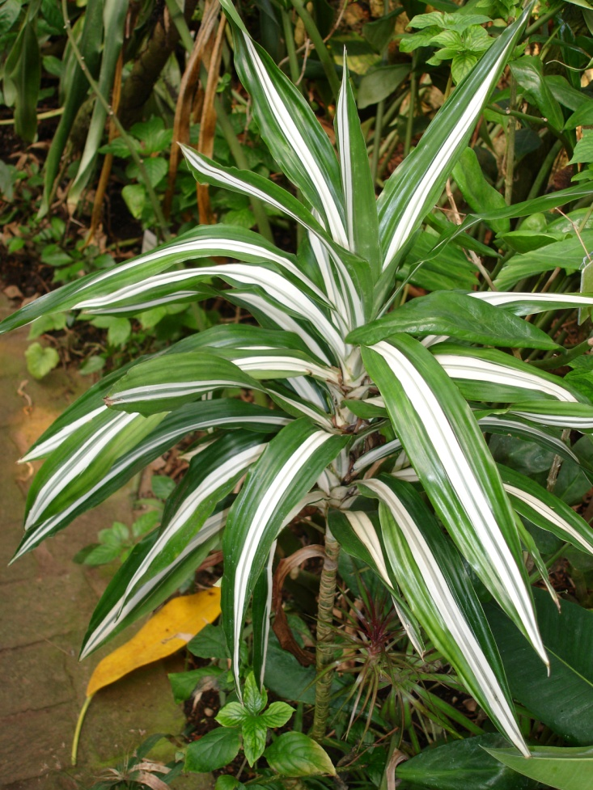
127
Dracaena deremensis ‘Warneckii’
Striped Dracaena
greengrowerindia.com
wikimedia.org
Notes:
http://www.greengrowerindia.com/files/products/images/162.jpg
http://upload.wikimedia.org/wikipedia/commons/2/21/Dracaena.deremensis.Warneckii.jpg

Slide 21
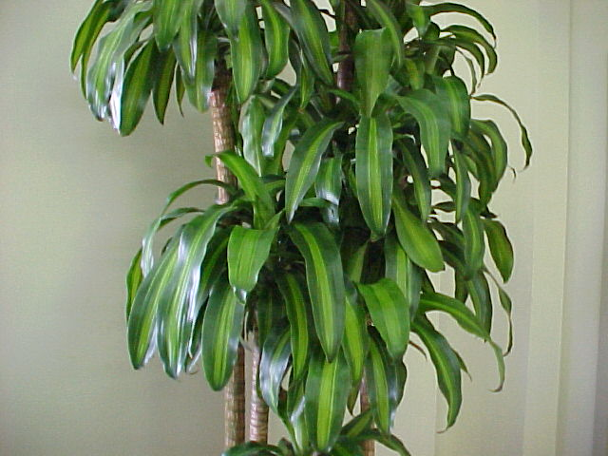
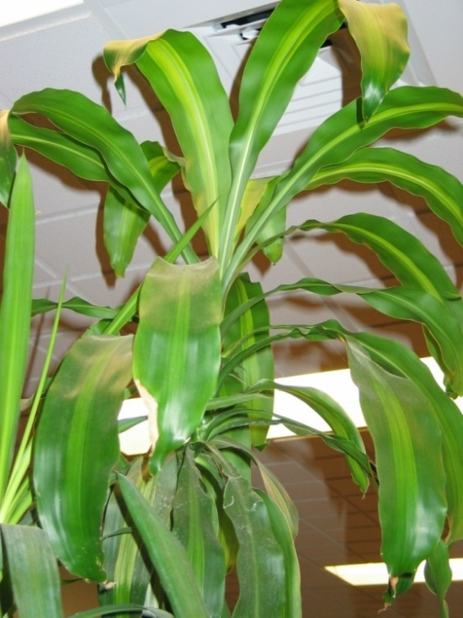
128
Dracaena fragrans ‘Massangeana’
Corn Plant Dracaena
Mgonline.com
Notes:
Mgonline.com

Slide 22
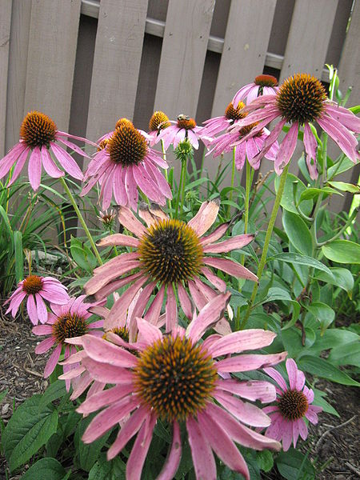
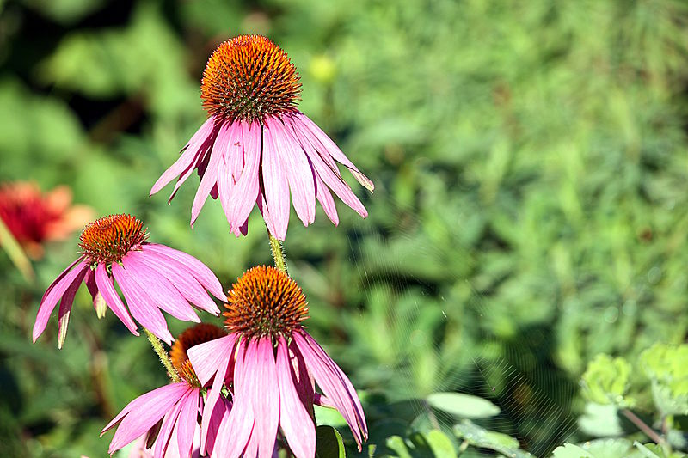
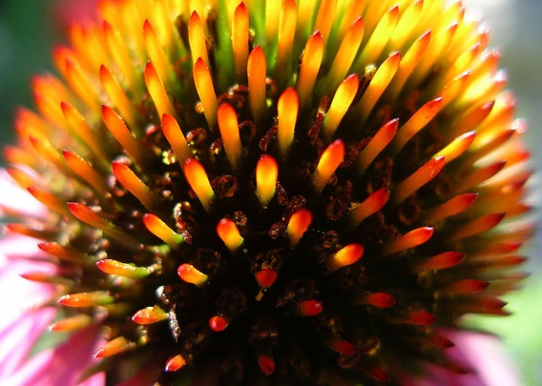
129
Echinacea purpurea
Purple coneflower
darrell.barrell
wikimedia.org
Notes:
({{Information |Description = A stand of ''Echinacea purpurea'' |Source = I created this work entirely by myself. |Date = 6 August 2009 |Author = Ed! (Photography) |other_versions )
(== Beschreibung == {{Information |Description=Asteraceae |Source=Eigenes Werk (own work) |Date=2008-9-9 |Author=Hedwig Storch |Permission= |other_versions= }} <!--{{ImageUpload|basic}}--> == Licensing: == )
(author: darrell.barrell description: closeup of echinacea purpura flower)

Slide 23
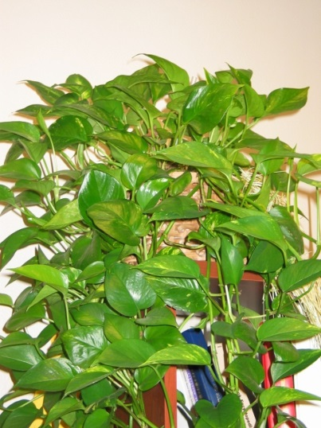
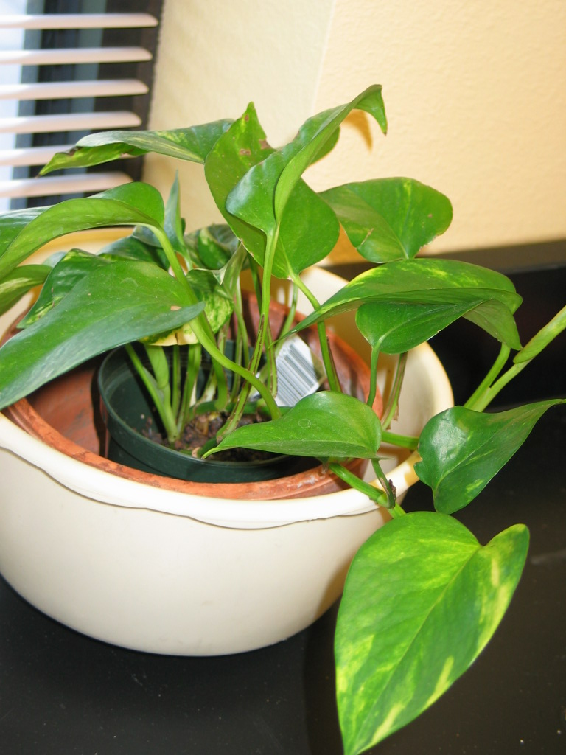
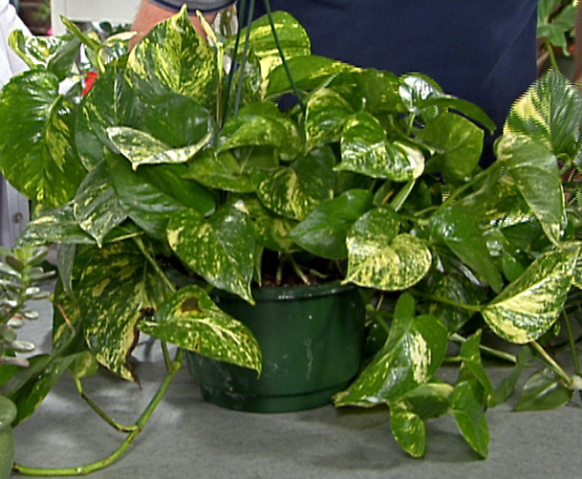
130
Epipremnum aureum cv.
Golden Pothos, Devil’s Ivy
Img.hgtv.com
Notes:
Photo courtesy of Allison Touchstone
Img.hgtv.com

Slide 24
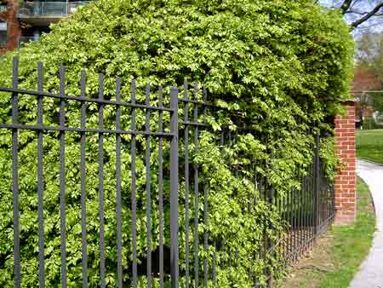
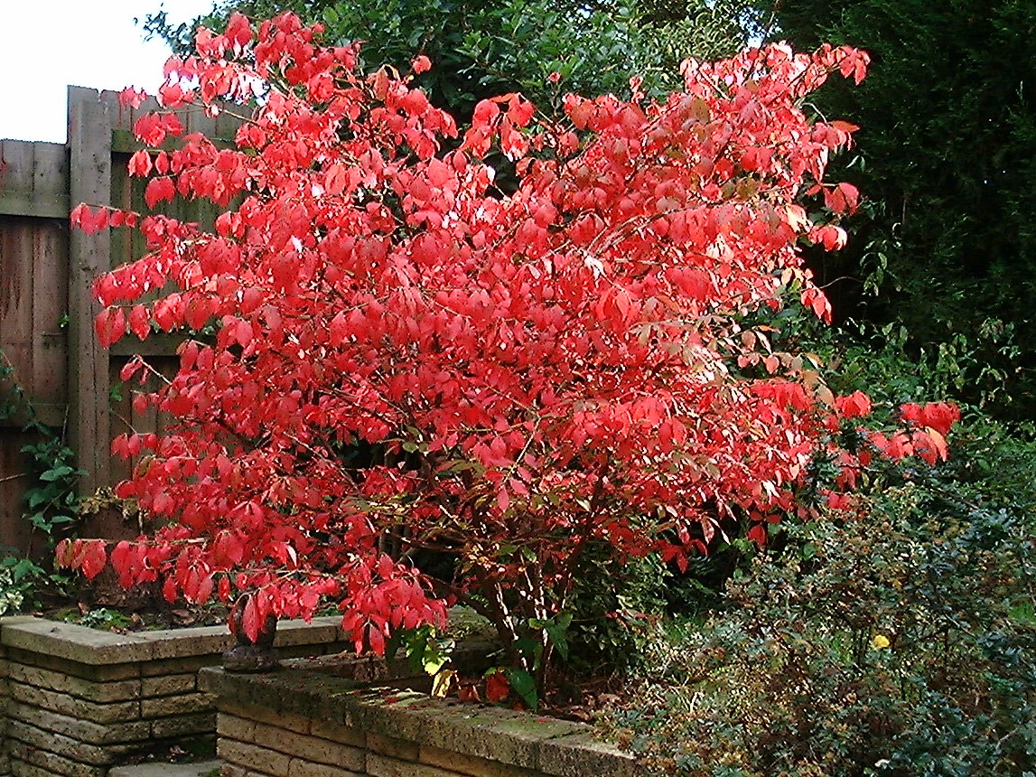
131
Euonymus alatus
Winged Euonymus
inmygarden.org
wikipedia.org
Notes:
(== Summary == {{Information| |Description = Euonymous Alatus in autumn colour |Source = self-made / en.wikipedia.org |Date = created 3. Oct. 2002 |Author = Chris Barton/Gif absarnt |Permission = )
( winged euonymus Category:Euonymus alatus Image © [http://www.inmygarden.org/ Sue Sweeney]{{GFDL}}See this page for further copyright information.)

Slide 25
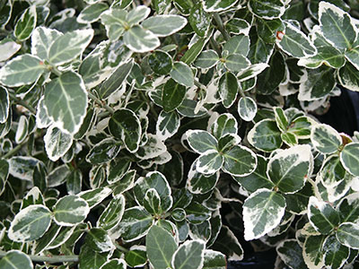

132
Euonymus fortunei cv.
Wintercreeper
pendernursery.com
Wikipedia.org
Notes:
http://www.pendernursery.com/Images/Euonymus-fortunei-%27Emerald-.jpg
Wikipedia--Permission is granted to copy, distribute and/or modify this document under the terms of the GNU Free Documentation License, Version 1.2 or any later version published by the Free Software Foundation; with no Invariant Sections, no Front-Cover Texts, and no Back-Cover Texts. A copy of the license is included in the section entitled "GNU Free Documentation License".

