Slide 1
PARASITES
By: Vet Science

Slide 2
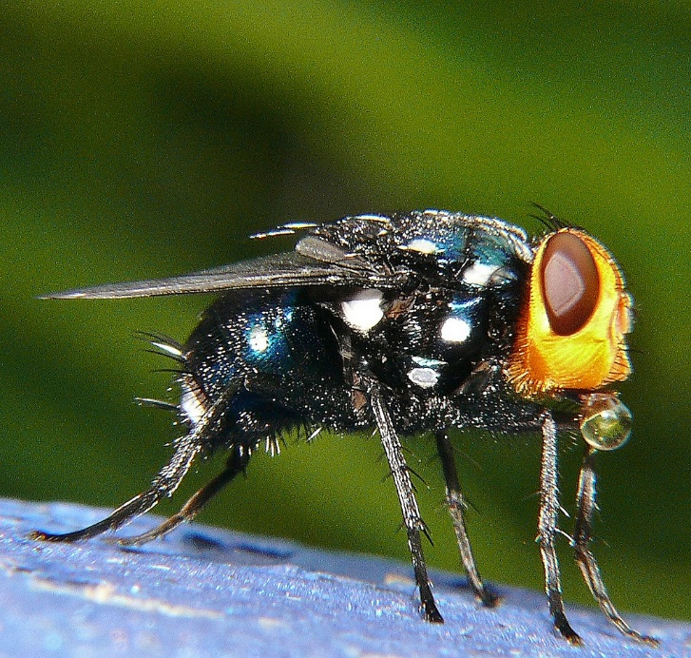
Blowfly (family calliphoridae)

Slide 3
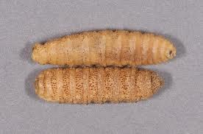
Catwarble

Slide 4
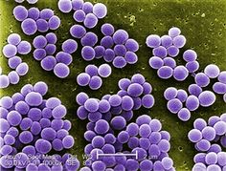
Cocci

Slide 5
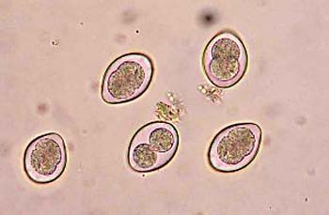
Coccidia

Slide 6
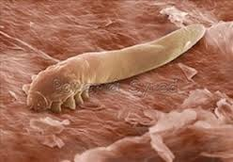
Demodectic Mite

Slide 7
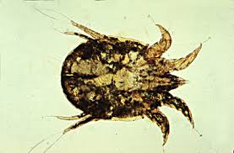
Ear Mite

Slide 8
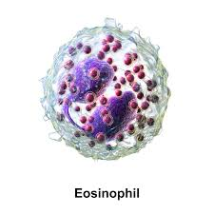
Eosinophils

Slide 9
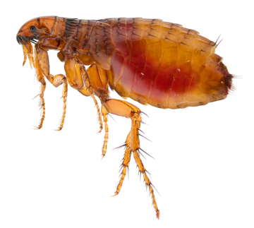
Flea

Slide 10
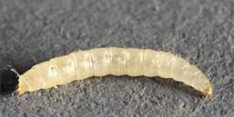
Flea Lava

Slide 11
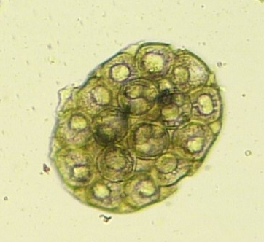
Flea Tapeworm Egg

Slide 12

Flea Tapeworm Segment

Slide 13
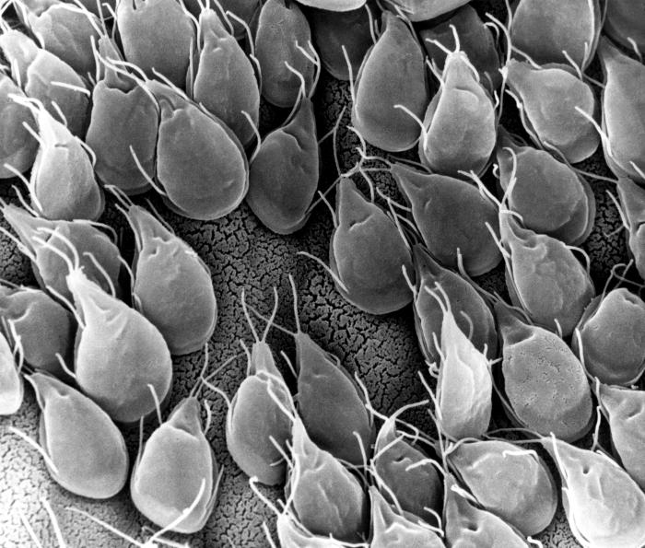
Giardia

Slide 14
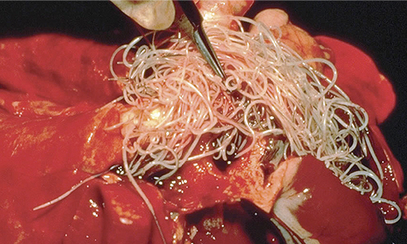
Heartworm Adult

Slide 15
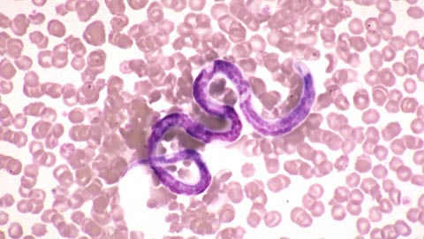
Heartworm Microfilaria

Slide 16
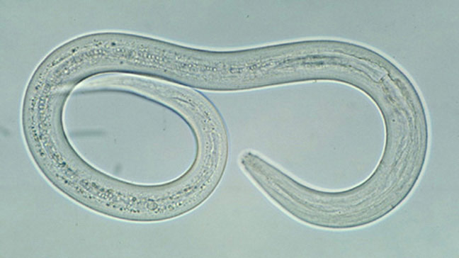
Hookworm Adult

Slide 17
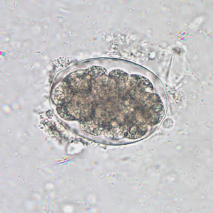
Hookworm Egg

Slide 18
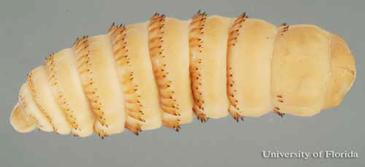
Horse Bots

Slide 19
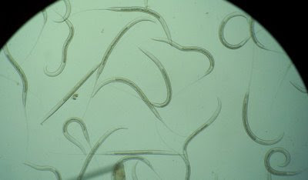
Horse Stronglyes

Slide 20
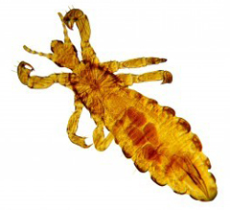
Biting Lice

Slide 21
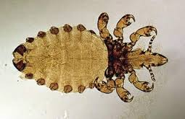
Sucking Lice

Slide 22
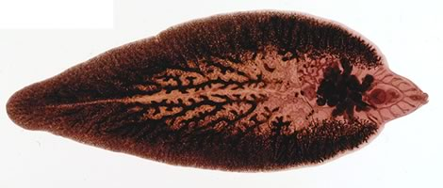
Liver Fluke

Slide 23
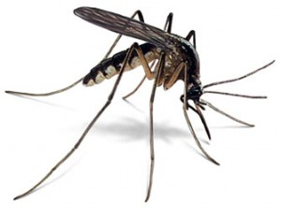
Mosquito Adult

Slide 24
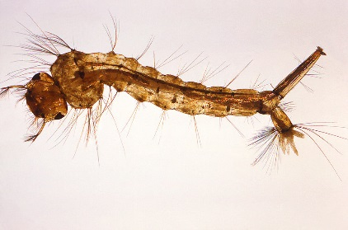
Mosquito Larva

Slide 25
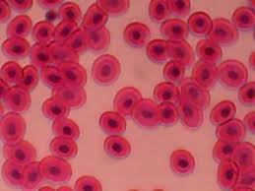
Red blood Cells

Slide 26

Roundworm Adult

Slide 27
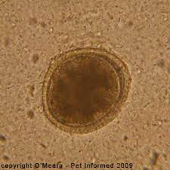
Roundworm Egg

Slide 28
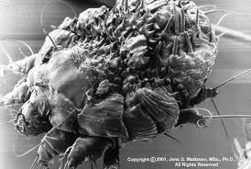
Sarcoptic Mite

Slide 29
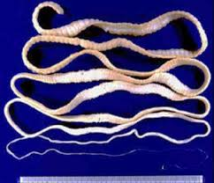
Taenia Tapeworm

Slide 30
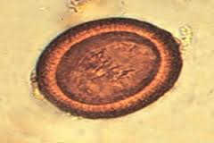
Taenia Tapeworm Egg

Slide 31
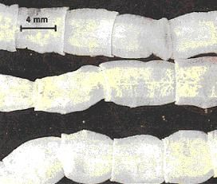
Taenia Tapeworm Segment

Slide 32
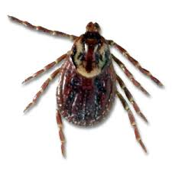
Tick- American Dog

Slide 33
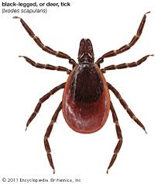
Tick- Black Legged Deer

Slide 34
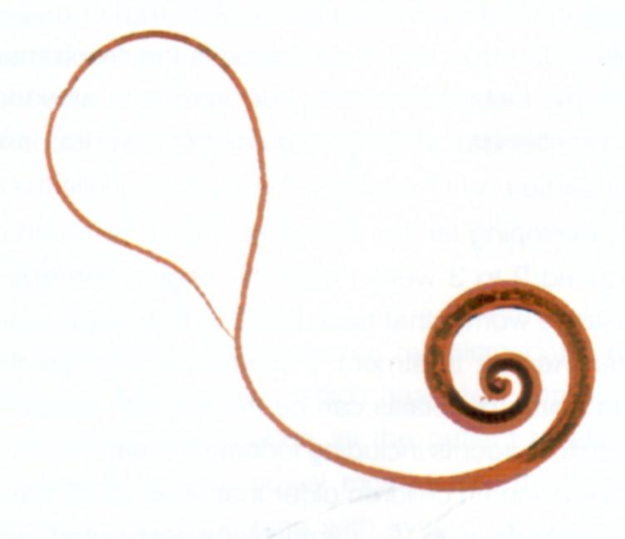
Whipworm

Slide 35
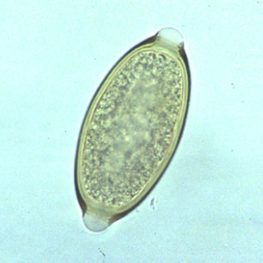
Whipworm Egg

Slide 36
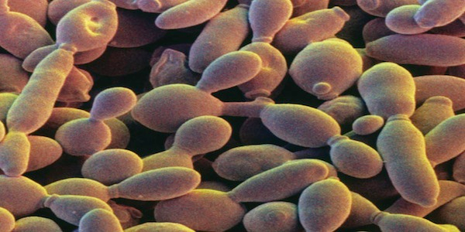
Yeast

